Slide 1

Proyect 1
Criminal Incidence of the CDMX and its different dimensions.
Benjamín Oliva
David Mariscal
Vicente Pliego

Slide 2
The core message
The crime problem in our days its the greater challenge of our society, not only for the damage that cause in our patrimony, or in our tranquility bus also because seems to see like irresoluble, tough to confront and like something that its out our hands.
We think that its not.
We need to see it, to analyze it, study, and make a reflection of it.
Only when we see like our problem, we can do something.
So these exercise try to be a description of these problem in México City.

Slide 3
1.- What are the main crimes that occur in Mexico City?
2.- What correlation exists between the main crimes?
3.- At what time do the main crimes occur?
4.- Where do crimes occur?
5.- Relationship between socio-economic level and crime incidence
6.- Incidence of crimes by geographical area in México City.
The questions
The Data
Carpetas de Investigación PGJ de la Ciudad de México.
https://datos.cdmx.gob.mx/explore/dataset/carpetas-de-investigacion-pgj-de-la-ciudad-demexico/table/?disjunctive.ao_hechos&disjunctive.delito
Directorio Estadístico Nacional de Unidades Económicas.
https://www.inegi.org.mx/app/mapa/denue/
Códigos Postales por Colonia.
https://www.correosdemexico.gob.mx/SSLServicios/ConsultaCP/CodigoPostal_Exportar.aspx
Alcaldia_Precio_m2.csv.
https://www.entrepreneur.com/article/342506
meter2xcolonyxviolence.csv
https://datos.cdmx.gob.mx/explore/dataset/coloniascdmx/export/

Slide 4
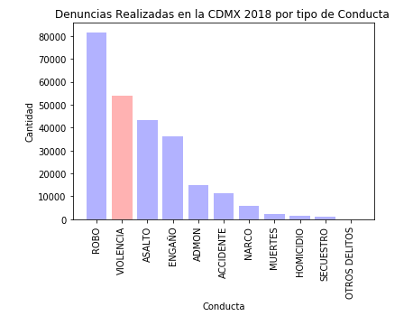
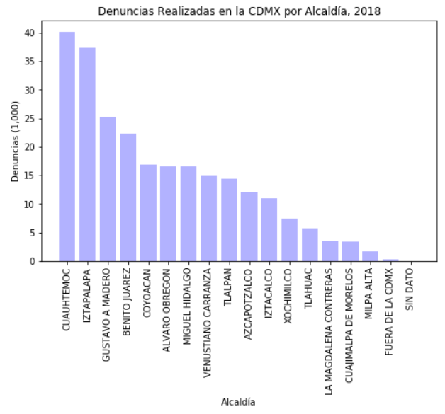
Analysis process

Slide 5
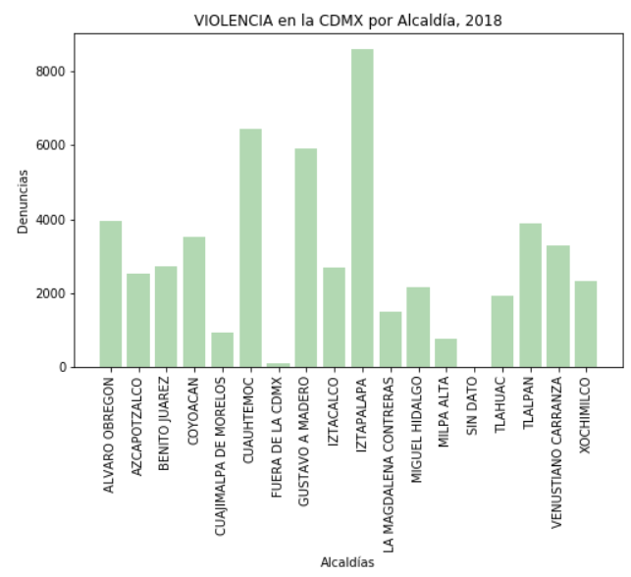
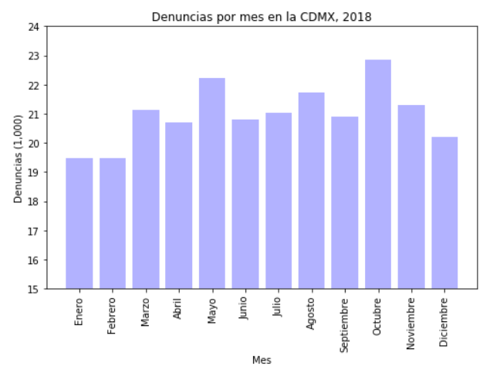
Analysis process

Slide 6
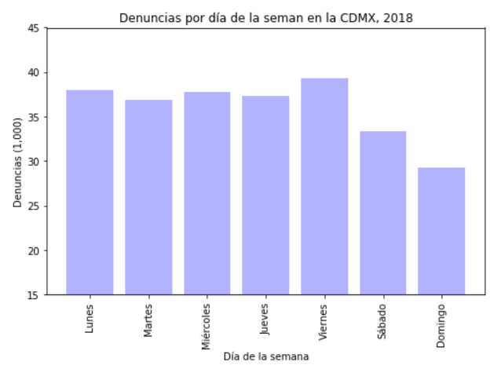
Analysis process

Slide 7
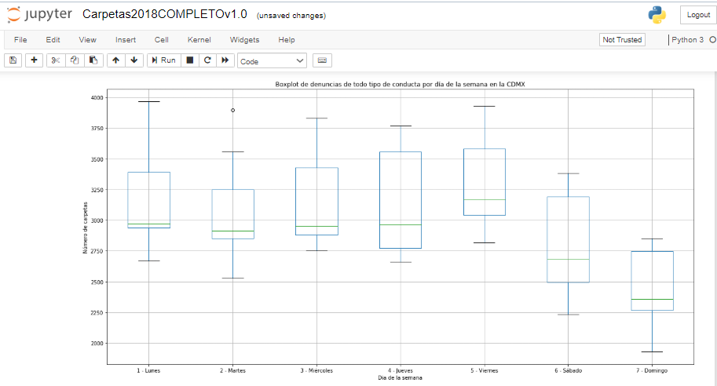
Analysis process

Slide 8
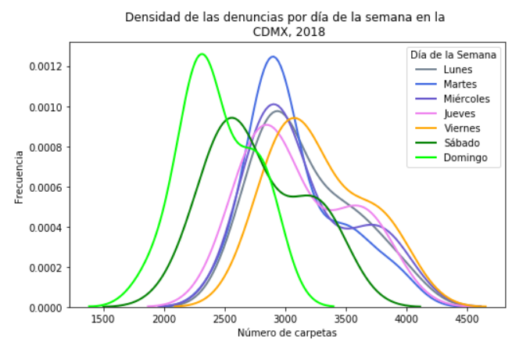
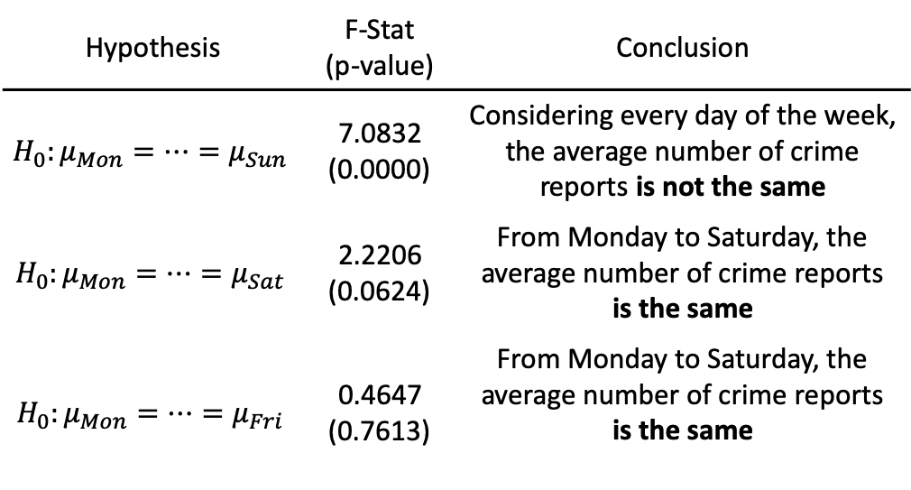
Analysis process
Hypothesis | F-Stat (p-value) | Conclusion
$$H_{0}:μ_{Mon}=…=μ_{Sun}$$ | 7.0832 (0.0000) | Considering every day of the week, the average number of crime reports is not the same
$$H_{0}:μ_{Mon}=…=μ_{Sat}$$ | 2.2206 (0.0624) | From Monday to Saturday, the average number of crime reports is the same
$$H_{0}:μ_{Mon}=…=μ_{Fri}$$ | 0.4647 (0.7613) | From Monday to Saturday, the average number of crime reports is the same

Slide 9
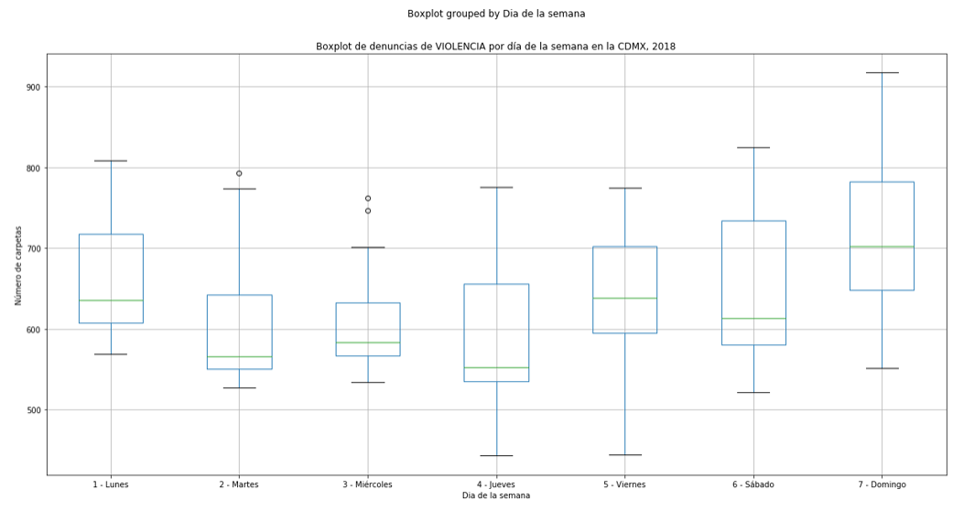
Analysis process

Slide 10
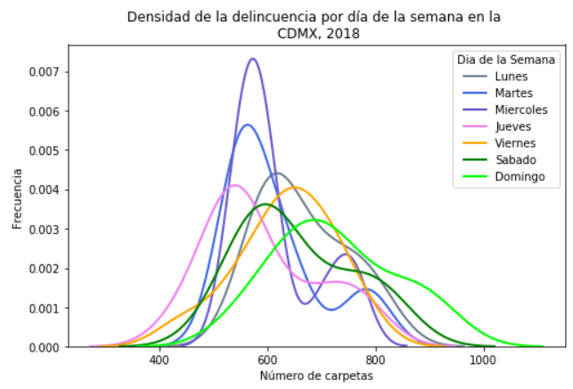
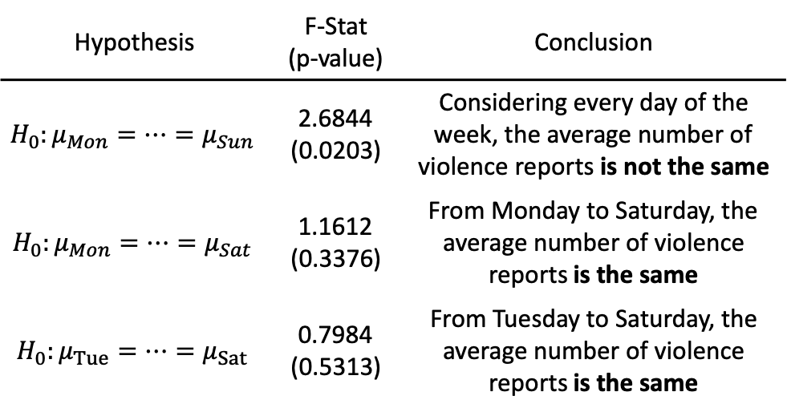
Analysis process
Hypothesis | F-Stat (p-value) | Conclusion
$$H_{0}:μ_{Mon}=…=μ_{Sun}$$ | 2.6844 (0.0203) | Considering every day of the week, the average number of violence reports is not the same
$$H_{0}:μ_{Mon}=…=μ_{Sat}$$ | 1.1612 (0.3376) | From Monday to Saturday, the average number of violence reports is the same
$$H_{0}:μ_{Tue}=…=μ_{Sat}$$ | 0.7984 (0.5313) | From Tuesday to Saturday, the average number of violence reports is the same

Slide 11
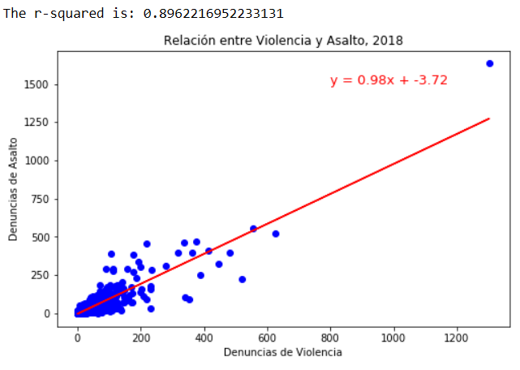
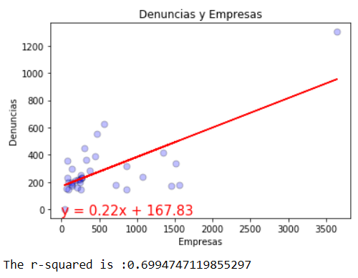
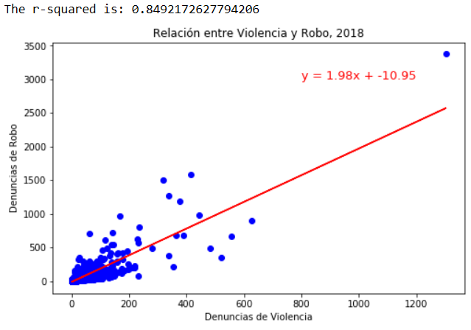
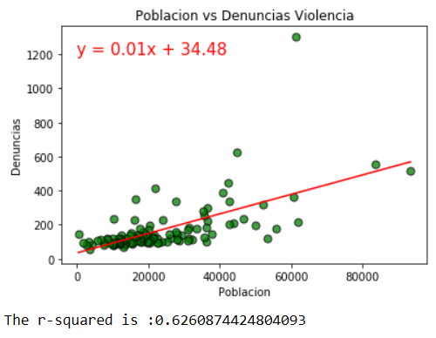
Analysis process

Slide 12
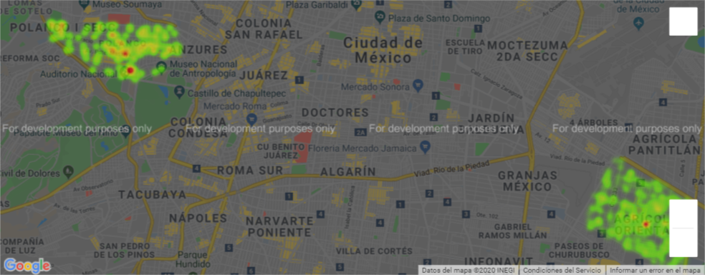
Analysis process

Slide 13
Conclussion
The Family Violence its inside our homes, Its relations with our density population, but its most important, generate outside violence too.
Its correlated with assaults and robbery.
Noting to see with the Price of the House.
We need to have a new approach to this phenomena not like outside generator, but inside, we need expend more resources checking was going on inside the family, tan in guns, armory, police.
Domestic Violence The most important education and socialization environment of the individual is the family. Individual and social values ​​are learned in the family, which are then projected in the community. In Mexico we find alarming data of domestic violence. Regarding the correlation between domestic violence and the propensity to generate a violent environment in an entity or population, the two factors that are most often associated with the development of violence are direct family members who are violent and / or who abuse toxic substances. Growing up and living in an environment of domestic violence can have serious physical and psychological effects on the individual, whether male or female. Its effects are different depending on each person, but in no case are they positive. They disrupt self-esteem and affections and lead to a defensive relationship, not infrequently loaded with resentment, frustration and resentment. The silence and introspection of the young people who join gangs and gangs is a clear symptom of fear, caution and distrust, in front of everything and everyone around them. When in a community domestic violence is the rule and not the exception, this form of coexistence moves to the streets and public spaces. Children and young people are accustomed to living in violence, without affection and without respect
http://www5.diputados.gob.mx/index.php/camara/Centros-de-Estudio/CESOP

